Slide 1







Video guides
Explore empower® Express features and tools
Brand Control
Content Creation
Content
Enablement

Slide 2
empower® Express Lite Overview
01

Slide 3




How does it work?
empower® Express, a seamlessly integrated PowerPoint add-in,
designed to make it easier, faster and more effective
to create better, more impactful presentations
Four sets of tools
Company
content
library
Graphic
resource
library
Productivity
and layout
tools
Advanced
charting
tools
1
2
3
4
> Video Quick
> Video Detailed
> Video Quick
> Video Detailed
> Video Quick
> Video Detailed
> Video Quick
> Video Detailed
IMPACT: Create better presentations in less time
empower® Express: easier | faster | better

Slide 4
empower® Lite videos
01 | Introducing empower® Lite
VIDEO
02 | empower® Lite – formatting overview
VIDEO
03 | Waterfall charts
VIDEO
04 | Marimekko charts
VIDEO
05 | Gantt charts
VIDEO
06 | Advanced line charts
VIDEO
07 | Excel linking – charts, tables, text boxes
VIDEO
08 | Productivity tools
VIDEO
09 | Layout tools
VIDEO

Slide 5
empower® Lite
Toolbar guides
02

Slide 6
The empower® Lite ribbon – video guides
Support
(2m 38s)
Finalize
(4m 12s)
Text
(4m 23s)
Layout tools
(11m 48s)
Color
(1m 5s)
Insert
(6m 44s)
NOTE: Your toolbar may look different, due to different editions, differently sized monitors and different screen resolutions

Slide 7
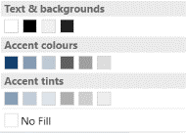
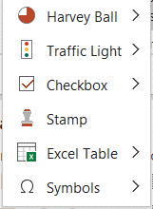
Overview of empower® Express Lite ribbon
Presentation
PRESENTATION SETTINGS – to set language, page no. footer
CORPORATE DESIGN CHECK –checks conformity to your design
SPELLCHECK language
PRESENTATION TOOLS – slide protection, layout cleaner, remove animations, remove notes/comments
SEND/ SAVE SLIDES – send or save whole presentations or single slides and selections from directly within PowerPoint
Charts
EMPOWER® CHART– create waterfall charts and other charts with advanced formatting tools and features
GANTT CHART – create GANTT and project charts quickly and easily and on brand
MORE – Excel links, user settings, about info.
Colour
FONT/ FILL/ LINE – shows only your design approved colours
Insert
AGENDA – automated Agenda Editor
FAVOURITES – Right hand mouse click on any library element to add them to your favourites for quick access
PRESENTATION – Access 10k+ design graphics and layouts to give your presentation a more professional finish
SLIDES – Access professionally designed commonly used layouts and slides
Text
FONT DROPDOWN – shows only your design approved fonts
BULLET – applies your design approved bullets (not the Microsoft default bullets)
INCREASE/DECREASE INDENT – toggles through the text levels set in the template placeholders
Other handy PowerPoint text and paragraph formatting tools
TEXT ELEMENTS/ CHARTS/ TABLES – Access the customised building blocks of a slide: editable shapes, text boxes, charts, tables, to make new content creation easily and on brand
ICONS – Access free collection of editable icons
IMAGES – Free access to 2m+ images
SHAPES – standard PowerPoint shapes
MORE – Insert smart objects and
linked Excel tables
Layout tools
Tools to help with formatting, sizing, positioning and editing objects. See overleaf for further details
Support & Help
Access support links, help tools and about info.
Also change system language
NOTE: Your toolbar may look different, due to different editions, differently sized monitors and different screen resolutions

Slide 8
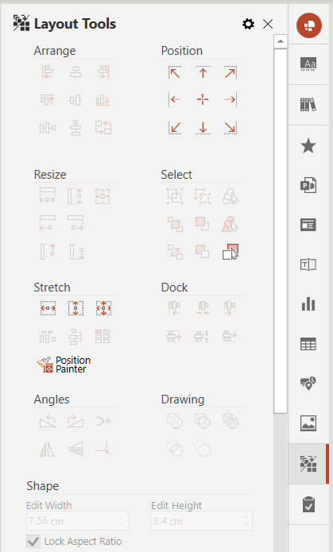
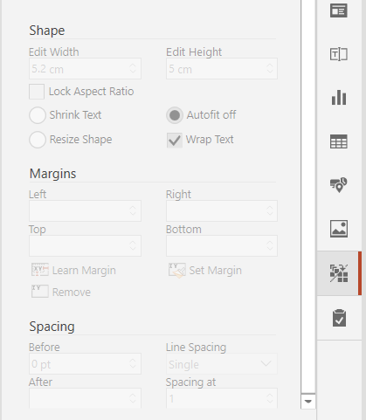

Tool overview – quick access pane & layout tools sidebar
Layout Tools
ARRANGE – alignment tools with the added extra of setting a ‘reference’ shape to lead the alignment. Includes a tool to distribute selected shapes horizontally or vertically. Also includes ‘Swap Elements’ tool to swap positions
POSITION – positions selected object(s) to the edges of the drawing area (as indicated by the placeholder on the master layout slide)
RESIZE – makes shapes the same size (width and/or height) and also extends objects to the same point
SELECT – native selection tools of group/ungroup, bring to front/back, open selection pane and new selections of ‘Select Same Colours’ and ‘Select Same Shapes’
STRETCH – Resizes a shape or group to the width, height or full size of the drawing area (as defined by the placeholder on the slide master). Also includes arrangement tools to control how groups of shapes are spaced and to create matrix grids
POSITION PAINTER – allows you to transfer the size and position of one element to another similar to the format painter function
DOCK – aligns two or more objects with one another. It is very useful for ‘gluing’ shapes together quickly and neatly
ANGLES – rotates, flips and adjusts corners
DRAWING – native tool that is usually hidden, that allows you to join, combine, fragment, intersect and subtract shape selections
SHAPE – allows for quick sizing, shape behaviour and text wrap specifications
MARGINS – allows for quick setting and application of margin settings
SPACING – quick access to useful native PowerPoint tools for line and paragraph spacing
User settings
Click the red circle to set ‘Always show sidebar’
1
1
Masters
Access template masters
2
2
3
Company
Access your company folders
4
3
Favourites
Add any folders, files or objects to your favourites folder
5
4
6
Presentations
Add graphics and diagrams to add interest to your presentations
7
5
8
Slides
Add useful page layouts & new ideas for commonly used pages
6
9
Text elements
Add useful page building blocks in your template style
10
7
11
Chart
Add pre-styled charts or create your own branded chart library
12
8
Table
Add pre-styled tables or create your own branded table library
13
9
Icons
Add editable icons
10
Images
Add images from UnSplash image library or set up your own company collections
11
Design check
Check that your file conforms to your company style guidelines
12
Layout tools
Access all the handy formatting, positioning and layout tools
13

